Slide 1



Poetry Analysis
By Nicholas and Loz

Slide 2
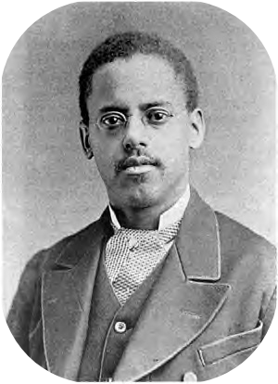
Lewis Grandison Alexander
Poet’s Name: Lewis Grandison Alexander
Age in Years: 45 years old
Born July 4, 1900.
Died November 25, 1945
Title of Poem: Japanese Hokku
“Lewis Grandison Alexander”

Slide 3
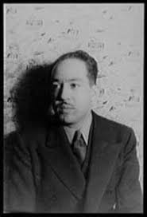
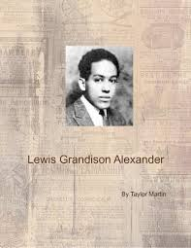

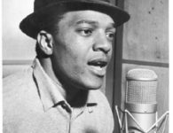
Pictures

Slide 4
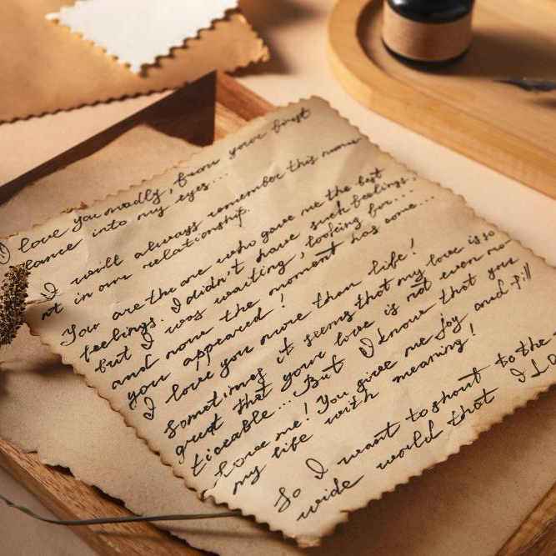
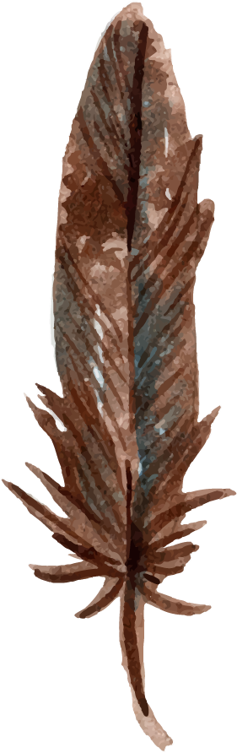
Background
This poem was written in 1925, and is called “Japanese Hooku”.
The poet grew up in a semi-hard life, so some ideas of how life can be questionable at times is present.
This poem talks about the world around us, and how it can be interesting at times.

Slide 5
Japanese Hooku
I. Life goes by moving, Up and down a chain of moods Wanting what’s nothing.
II. My soul is the wind Dashing down fields of Autumn: O, too swift to sing.
III. Listen to the rain Falling broken on the ground: Pity the sky once.
IV.
Knowing not at all
Who stands above me seeing:
Tears of gratitude.
V
The nightingale sings
My heart desires but the night Space swallows my voice:
VI.
I shall spend my moods
Like a rose discards leaves
And die without moods.

Slide 6
Japanese Hooku (cont.)
VII. Did you say a sound? Did you say the wind? Dashing Only my soul’s quick—
VIII. O moon of to-night Let me rest my head on you And hear my life sing.
IX. My ears burn for speech And you lie cold and silent Supinely cruel:
X. Look at the white moon The sphinx does not question more. Turn away your eyes.
XI. Thought that is no thought Poems buried in my heart Song that is no song …
XII The poetry of life? No, the picture of my dreams Flashing on my heart.
XIII I ride down the stream Between the earth and the sun On the moon’s shadow.
XIV Treading wearily A unit of the parade There is no escape.
XV. Within the shadow I am weaving the pattern Of a spider web.

Slide 7
Japanese Hooku (cont.)
Published in Poem-a-Day on April 25, 2021, by the Academy of American Poets.
XVI My heart like a shell Moans at the breast of the earth Being too full to sing.
XVII You are life’s fountain Springing from eternity Flow not recklessly.
XVIII I will wrap the song In the leaves of the lotus And send it to you.
XIX No words speak louder Than the tragic look of eyes Close yours out of love.
XX Why should I wander I who have known no surprise? Every day the same.

Slide 8
Poem Meter and Theme
This poem talks about how quickly life moves, and how unexpected it can be. Life can be fun sometimes, but be depressing at other times. The poem also talks about how life can be questionable sometimes, and how life can also be slow and boring as well.

Slide 9
Poem Form
This poem is in the form of a haiku
Other haikus are “Old Pond” and “Hokusai”
Haikus are written in a form where the first line is 5 syllables, the second is 7, and the third is 5 too.
1.
2.
3.

Slide 10
Poem Speaker and Sounds
This poem is in first person.
Some pronouns in this poem are “I, my, and me”
The speaker expresses a lot of emotions, using imagery
In the poem, there are several poetic devices.
Repetition- In stanza 7, the phrase “Did you say” was repeated twice
Imagery- This poem used a lot of imagery. Imagery is when words describe a location. Phrases like “Listen to the rain”, and “Dashing down fields of autumn” uses imagery.
Similes- This poem uses a few similes. Similes show that objects are similar usually using like or as. Some examples in the poem is “My heart like a shell.”

Slide 11
Japanese Hooku
I. Life goes by moving, Up and down a chain of moods. Wanting what’s nothing.
VII. Did you say a sound? Did you say the wind? Dashing Only my soul’s quick—

Slide 12
Poet and Poem Review
Here are some main aspects of the poet:
His name was Lewis Grandison Alexander.
July 4th, 1900 - November 25, 1945
He died in Washington D. C.
He began writing in 1917 (17yrs)
He was also and actor, playwright, and editor.
This poem has many poetic devices in it.
Some devices that were used a few times were:
Imagery- Imagery was used to bring the poem to life and make an idea of what the scene looks like.
Metaphors- Metaphors show that two objects are similar, and may share similar features
Similes- Similes use “like” and “as”. In the poem, “My heart like a shell” is an example of this.

Slide 13
Poem Speaker
This poem is in first person.
Some pronouns in this poem are “I, my, and me”
The speaker expresses a lot of emotions, using imagery

Slide 14
Sources
https://poets.org/poet/lewis-grandison-alexander
https://aaregistry.org/story/lewis-alexander-harlem-renaissance-contributor/
https://www.bookemon.com/read-book/269383
https://poets.org/poem/japanese-hokku

